Slide 1
What is express:
This is a server side web framework for node
Uses:
To Develop Server Side Rest API For Mobile, Desktop, Web Applications and IOT devices
Using template engine with express you can develop complete web site or web application too.
You can use react, vue or angular with express to develop complete web site or web application

Slide 2
What will be our learning strategy
Express Rest API Development
Working with template engine and express together
Working with react and express together
Deploy & Testing With Real server

Slide 3
Tools:
Node
WebStrom
Postman
Knowledge Required:
Node and JavaScript

Slide 4
My First
Express Application

Slide 5
Express JS
Routing

Slide 6
সার্ভার সাইডে দক্ষতার জন্য-
চারটি বিষয় ভালো করে বুঝতে হবে শিখতে হবে
Request
Response
Middleware
Database Operations

Slide 7
Response
Response Body
Response Header
Response Status
Response Cookies

Slide 8
Request Method
Post()
Get()
Put()
Delete()

Slide 9
Request get()
Create Simple Get Request
Simple Get Request With URL Parameter
Catch Request Header Simple Get Method

Slide 10
Request post()
Request
Request With URL Parameter
Request Header
Request JSON BODY
Request Multipart Form Data
Request File Upload

Slide 11
Middleware
Middle + Ware
মধ্যম + সতর্কতা
মাঝখানের সতর্কতা/সচেতনতা

Slide 12
Middleware
Request
Response
Use Of Middleware
User agent check, valid request check
Authentication, Authorization, Verification
Request Limiting
And other’s security measures

Slide 13
Middleware Placing
Application Level
Route Level

Slide 14
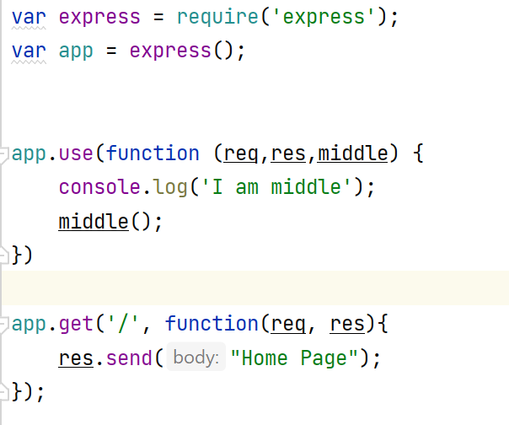
Application Level

Slide 15
Express JS Scaffolding:
Scaffolding allows us to easily create a skeleton for a web application.

